Slide 1


COMPUTER NETWORKS
PROJECT
Illuminating Connectivity: LiFi Technology for High-Speed Wireless Communication
Presented By : Anand Okade Ajay Kumar T.A Harsh Motwani

Slide 2

AGENDA
Background of the Study | 3
Problem Statement | 4
Framework | 5
Methodology | 6
Proposed Timeline | 7
Analysis | 8
Contact Information | 10

Slide 3


LiFi
Technology
LiFi, or Light Fidelity, is a wireless communication technology that uses light waves for data transmission. It offers high-speed, secure, and efficient connectivity by modulating LED light to transmit information.

Slide 4

Problem Statement
This project aims to create a Li-Fi communication system, utilizing LEDs for transmission and solar panels for reception. The goal is to provide a hands-on learning experience, making Li-Fi network programming accessible and demystifying its complexities for us.

Slide 5
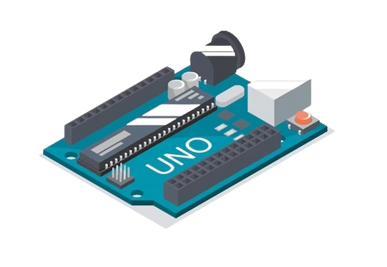
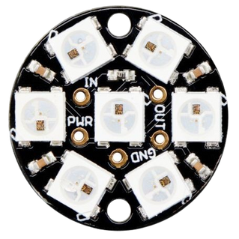
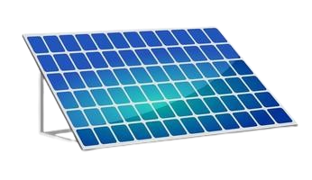

PROJECT COMPONENTS
Arduino Uno boards
LEDs for transmission
Solar panel for reception
Laptops for data display

Slide 6
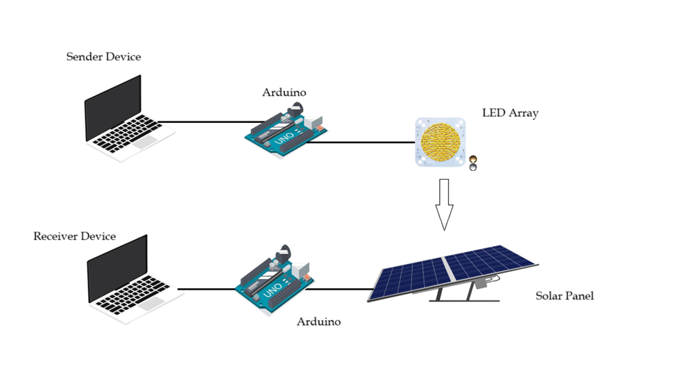
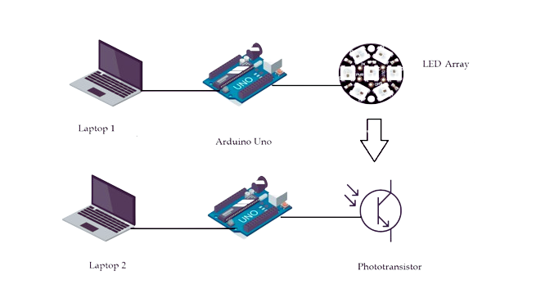
CIRCUIT DIAGRAM

Slide 7



CODE
Transmitter Code

Slide 8

CODE
Receiver Code

Slide 9
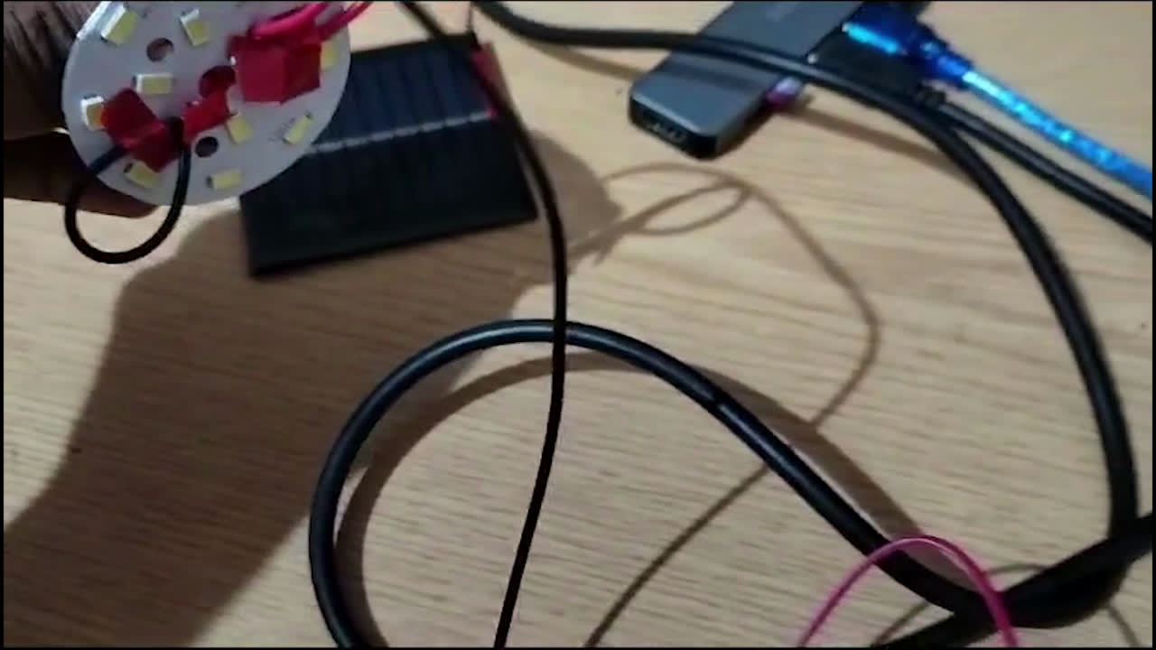

Slide 10


